Slide 1

HOSPITAL MANAGEMENT SYSTEM
MADE BY:
Yanvi Soni (18BCP130) - Group Leader
Trisha Baldha (18BCP118)
Swara Jani (18BCP113)
CE-18

Slide 2
ABSTRACT
The Hospital Management System is a project created in Java language with GUI implementation for better user interaction. It is an element of the medical informatics solutions and focuses mainly on the administration of the hospitals. It basically runs on the idea that the admin handles all the records in this. It is highly confidential as it contains all the personal information of doctors and patients. It also contains all the necessary information about the medicines and other facilities offered by the hospital.

Slide 3




MODULES OF HOSPITAL MANAGEMENT SYSTEM(HMS)
Patient Details
Patients
Doctors
Medicines
Facilities
Doctor Details
Medicine Details
Facilities

Slide 4
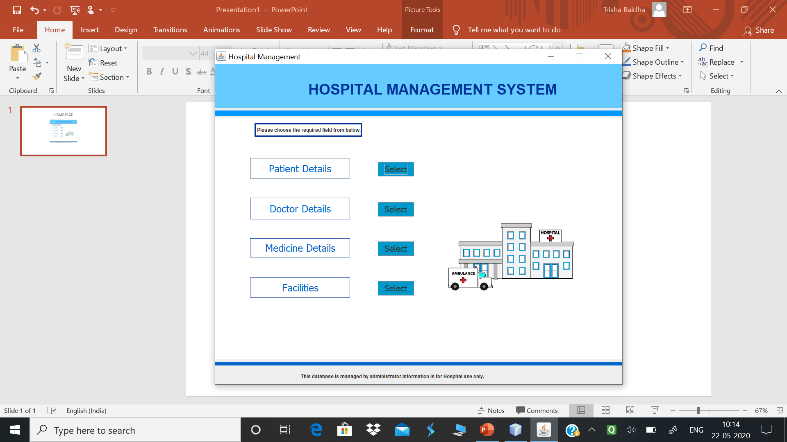
HOME PAGE
This application outlines the basic functionalities in hospital management system. It will be managed by administrator. The application is to be used by hospitals on their ends.
Patient Details
Doctor Details
Medicine Details
Facilities

Slide 5


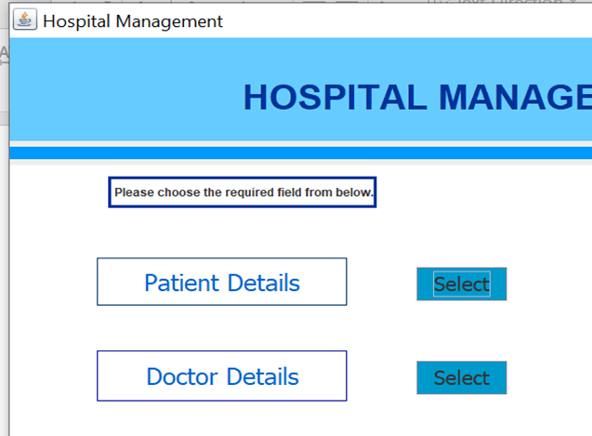
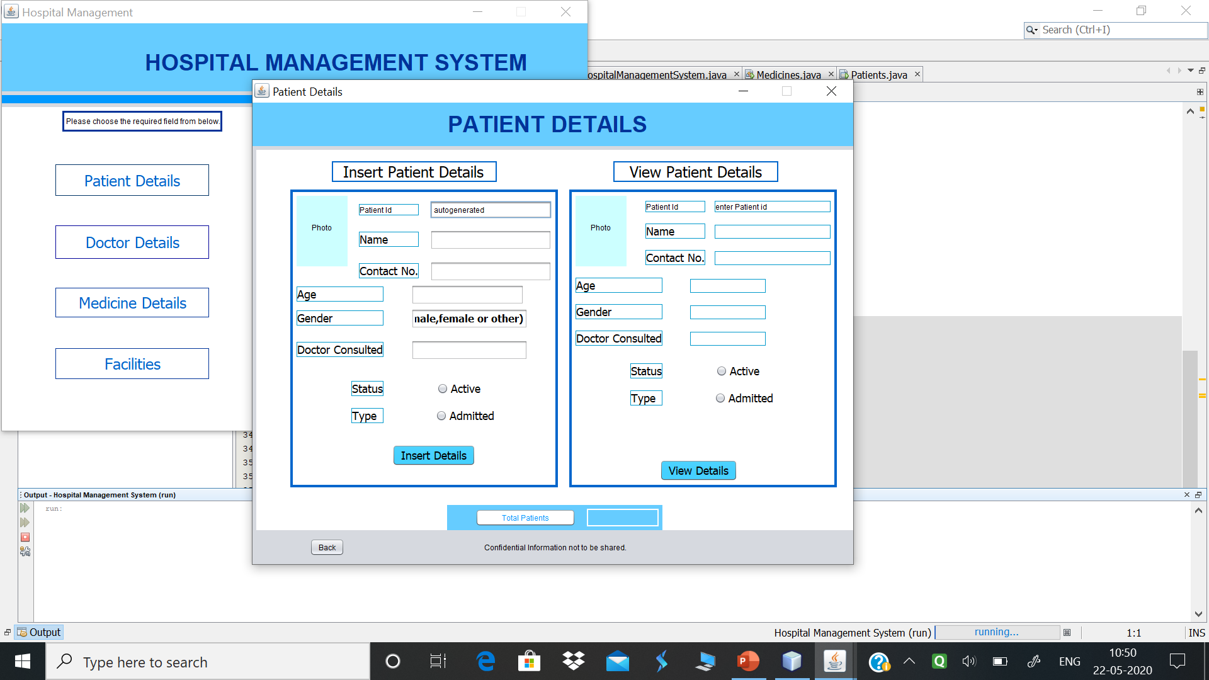

PATIENT DETAILS FRAME
Patient Registration module of our hospital management system is designed to manage vital information for the patient.
It encompasses the patient’s name, and contact information, birth date, doctor consulted, and insurance information.
Unique patient ID for tracking visits.
Back button leads to Home Page

Slide 6
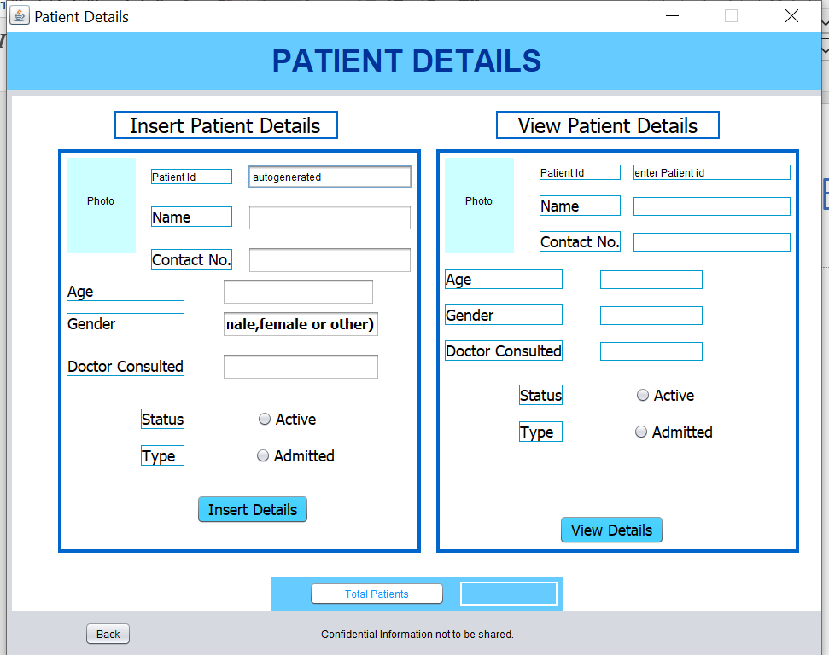
PATIENT DETAILS FRAME
It has various functionalities for storing and retrieving patient details.
It also shows count of total patients.
Details over here will not be shareable it will be for hospital use.
Insert Patient Details
View Patient Details
Total number of patients

Slide 7

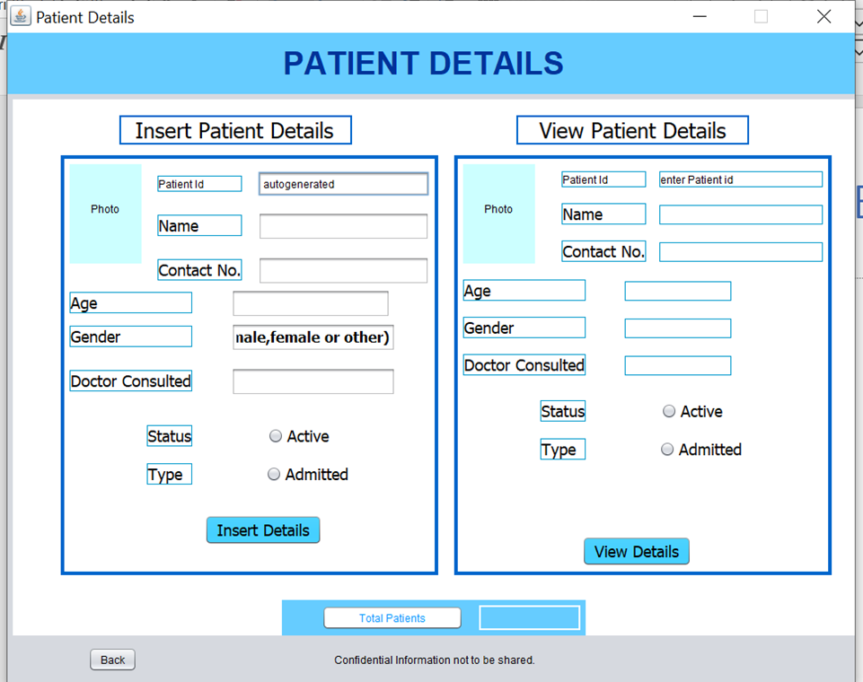


PATIENT DETAILS FRAME
Insert Patient Details
It covers details like
Patient Id which will be autogenerated
Name of the patient
Contact number of the patient
Gender and age of the patient
Status will be marked active if patient is getting treatment from hospital currently.
Patients will be of two category only consulting ones and admitted.
Radio buttons will allow selecting the status and type of patient.
This button will register the information if it was error free.

Slide 8

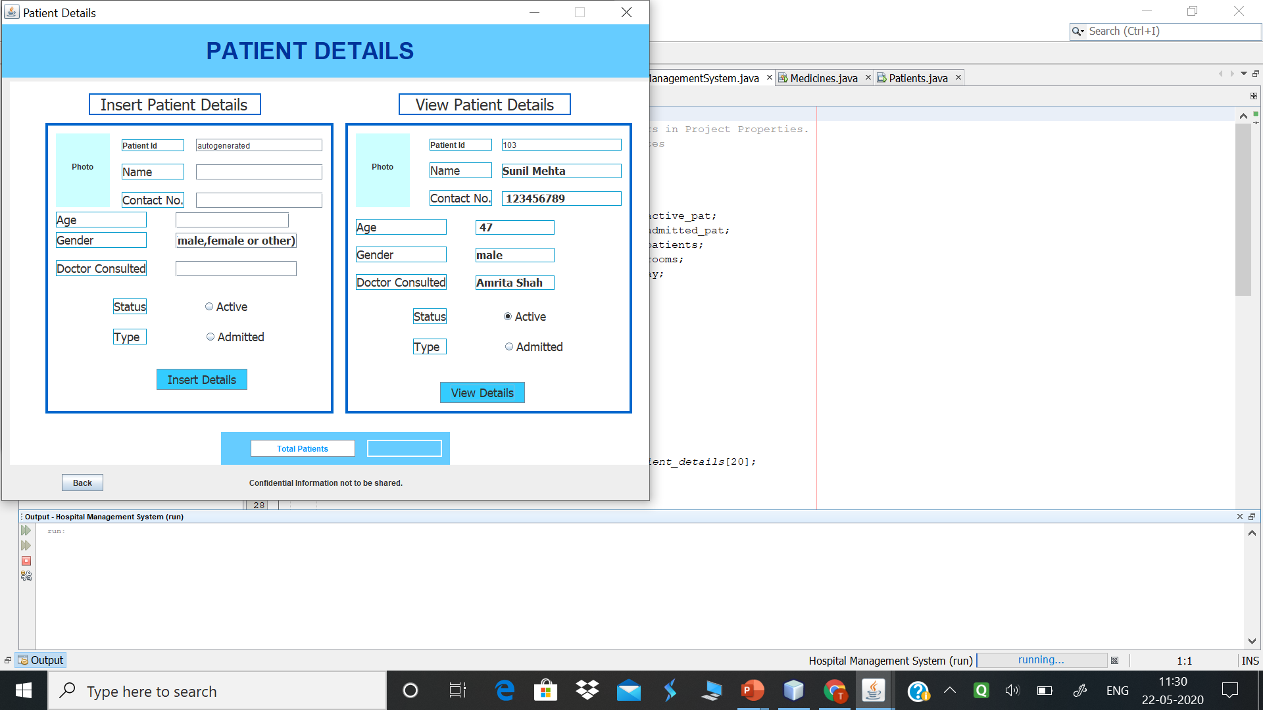
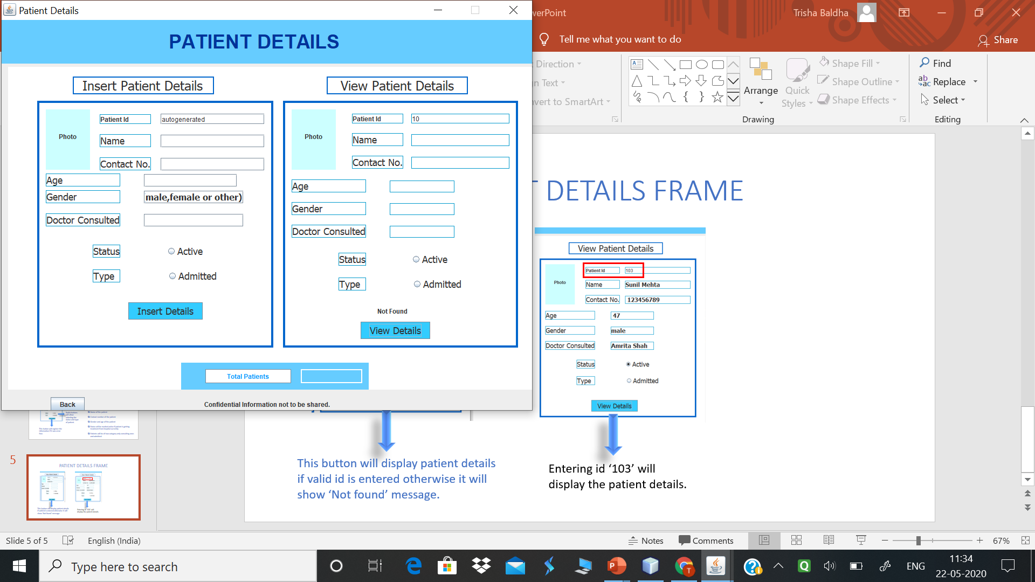



PATIENT DETAILS FRAME
View Patient Details
This button will display patient details if valid id is entered otherwise it will show ‘Not found’ message.
Entering id ‘103’ will display the patient details.
Not found message will be displayed.

Slide 9


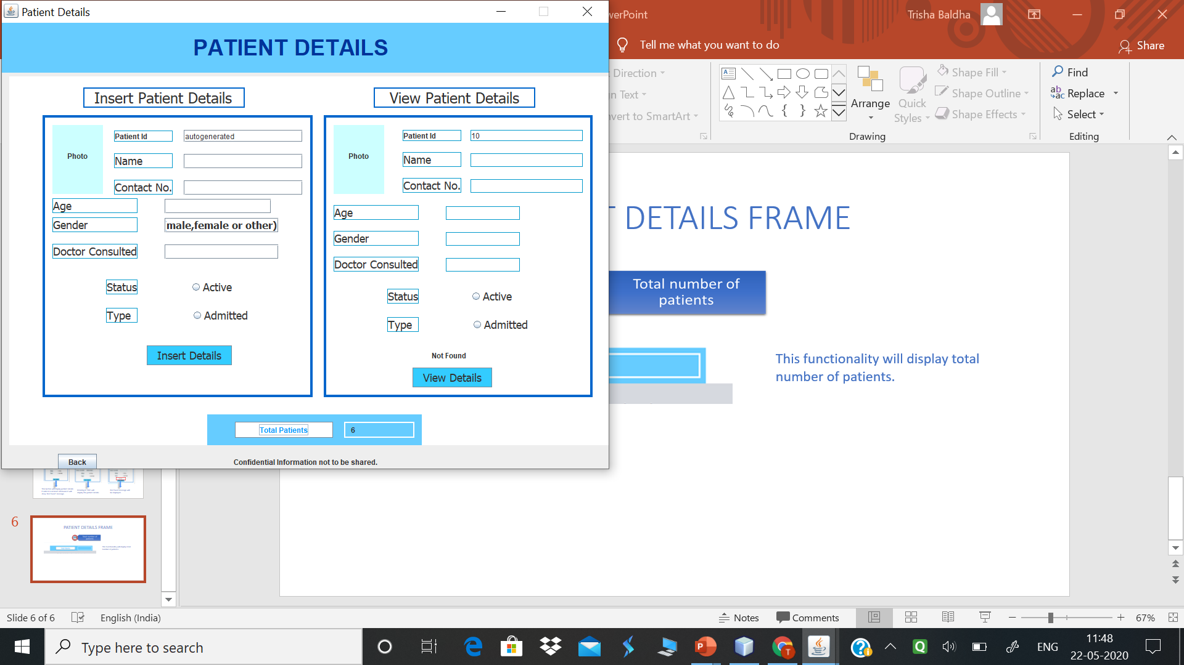
PATIENT DETAILS FRAME
This functionality will display total number of patients.

Slide 10
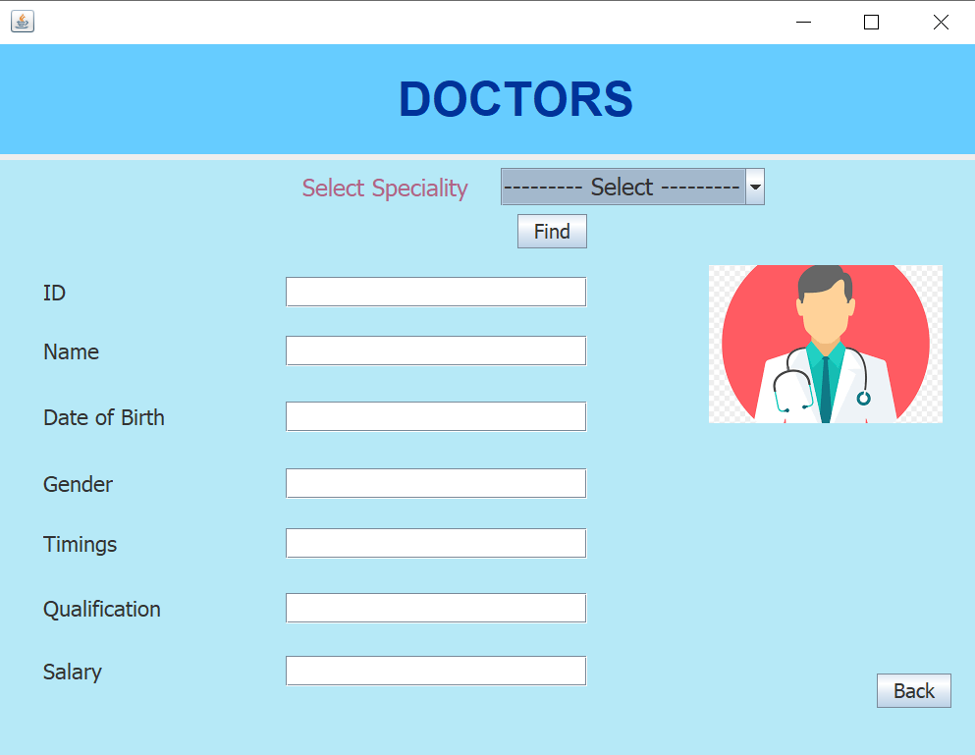
DOCTORS FRAME
Doctor Details
In this module, the details of the doctors working in the hospital are displayed.
It gives the information regarding the ID, name, date of birth, gender, timings, qualification and salaries.
The doctors are bifurcated on the basis of their specialties.
Back button leads to Home Page

Slide 11

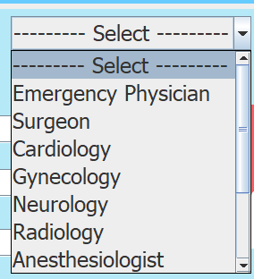
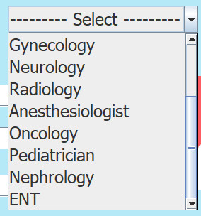
DOCTORS FRAME
Specialities
The combo box gives the user 11 choices of specialties(excluding the Select option).
The user can select one of them at once in order to know the information about the doctor operating in that particular field.

Slide 12
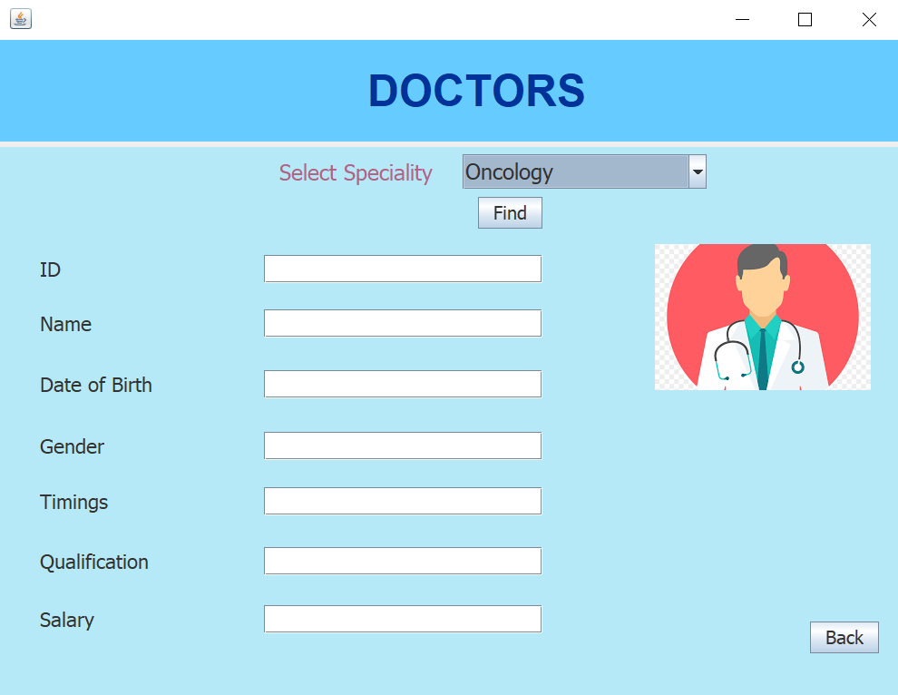


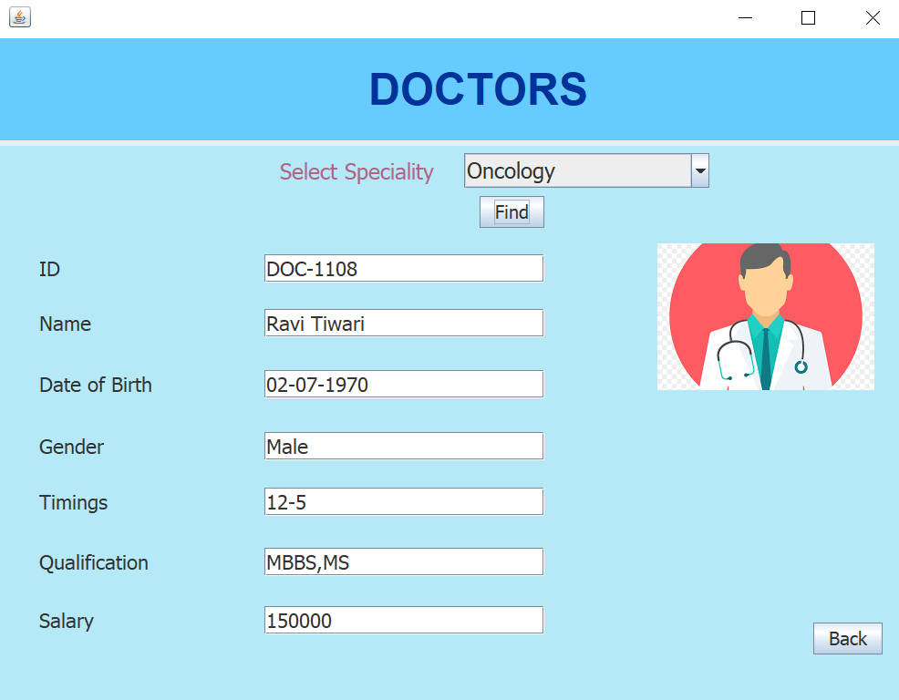

DOCTORS FRAME
Once we select the specialty, press the ‘Find’ button.
It will then display the information of the required doctor.

Slide 13
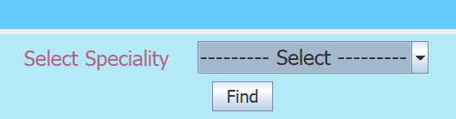
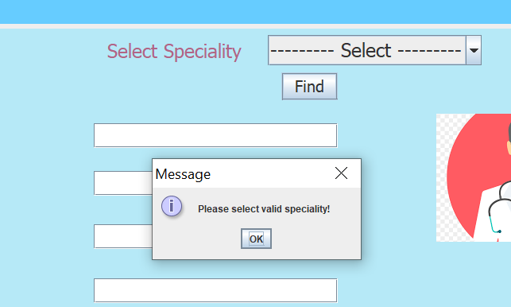
DOCTORS FRAME
However, if we press the ‘Find’ button without selecting any specialty, a popup box will appear with a message to select a valid specialty.
In this case, the information spaces will remain blank.

Slide 14
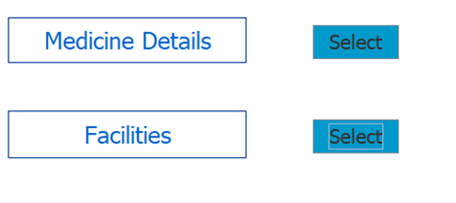

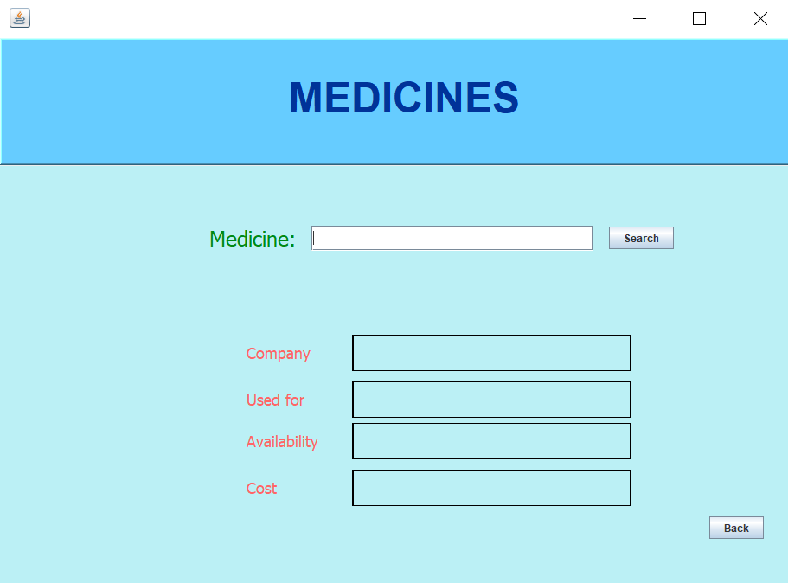
MEDICINES FRAME
Medicine Details
This frame will show the details of the medicines, i.e. it will display the name of the company which manufactured it, its uses, cost and the packets available.
Back button leads back to Home page.

Slide 15
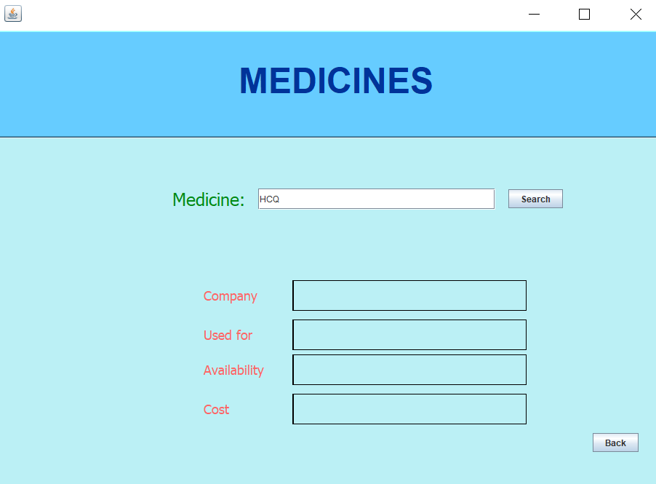


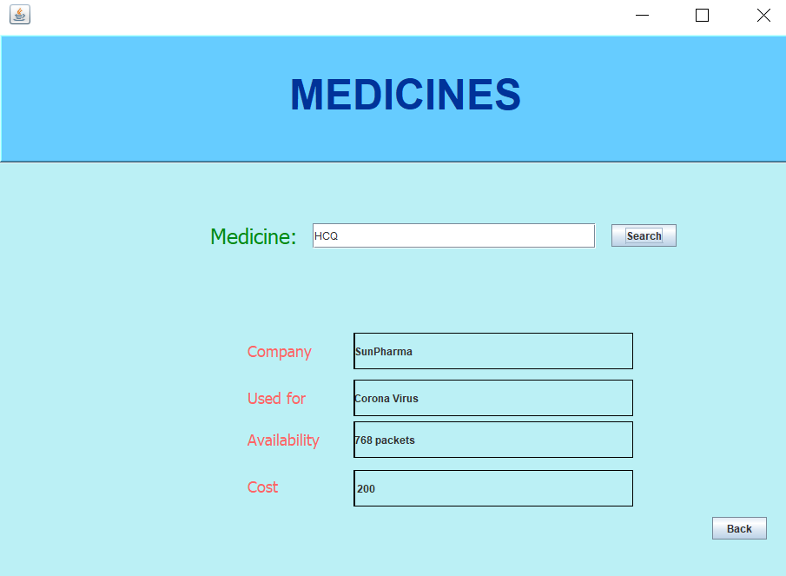
MEDICINES FRAME
Type the name of the medicine to be searched and then press the ‘Search’ button.
It will now display the details of the medicines.

Slide 16
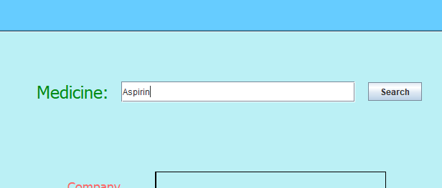
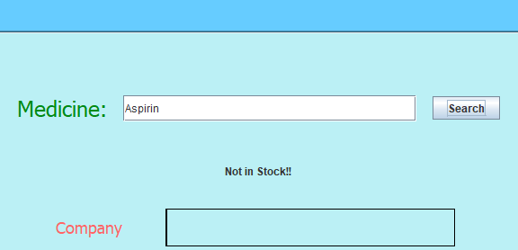

MEDICINES FRAME
However, if the medicine is not in the stock, then a message saying that will be displayed.

Slide 17
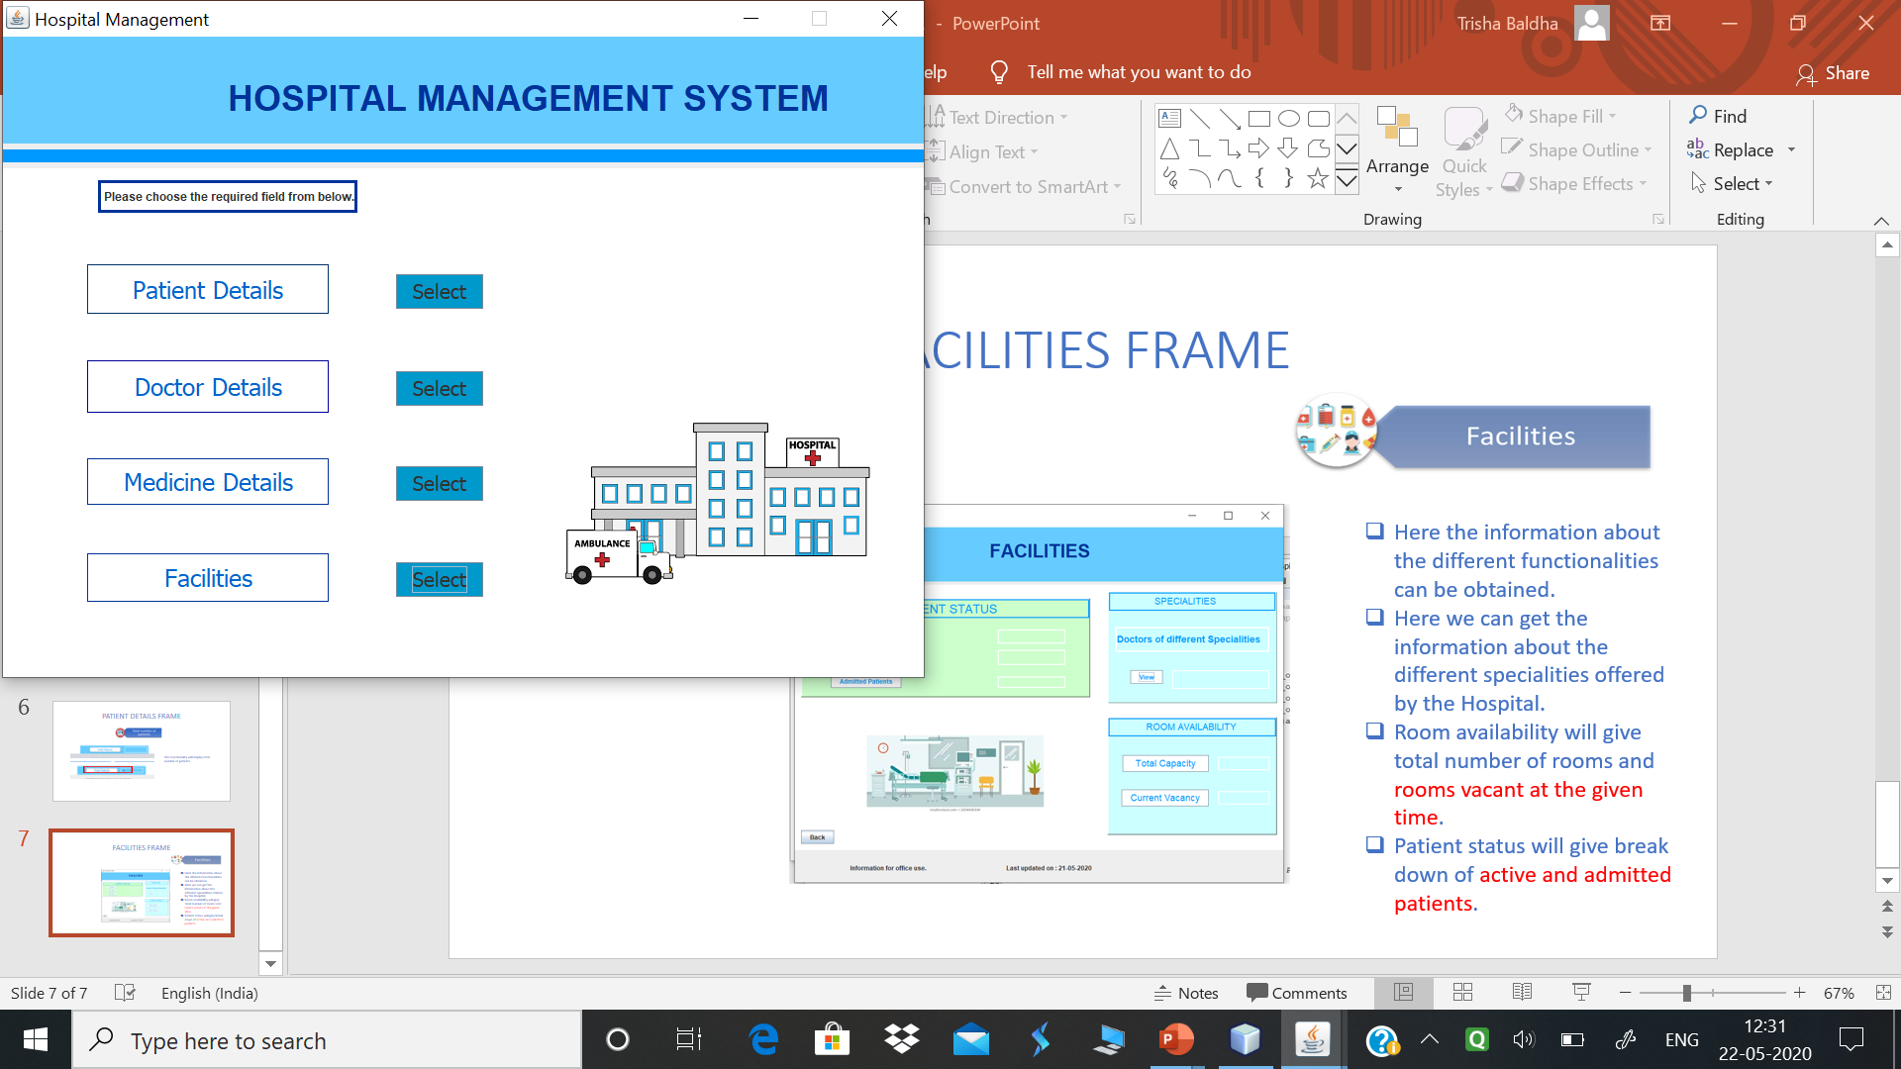


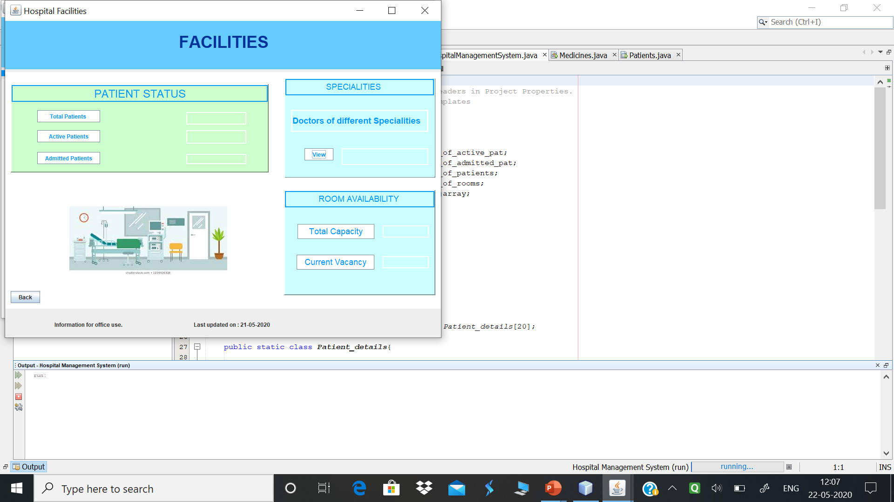

FACILITIES FRAME
Here the information about the different functionalities can be obtained.
Here we can get the information about the different specialities offered by the Hospital.
Room availability will give total number of rooms and rooms vacant at the given time.
Patient status will give break down of active and admitted patients.
Back button leads to Home Page

Slide 18
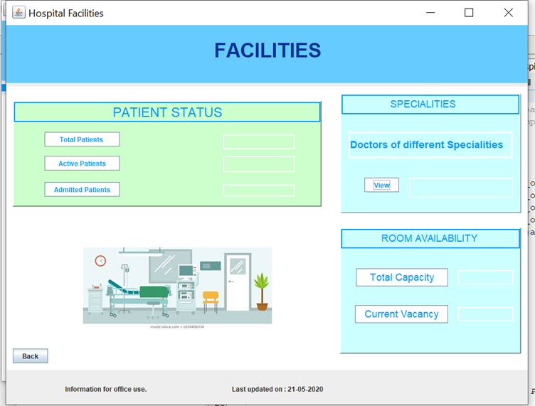


FACILITIES FRAME
It will allow various information retrieval.
Specialities
Patient Status
Room Availability

Slide 19
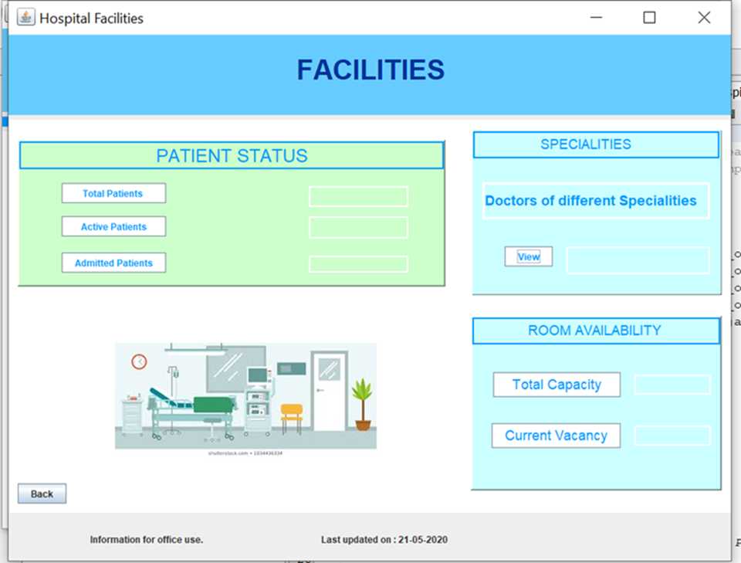
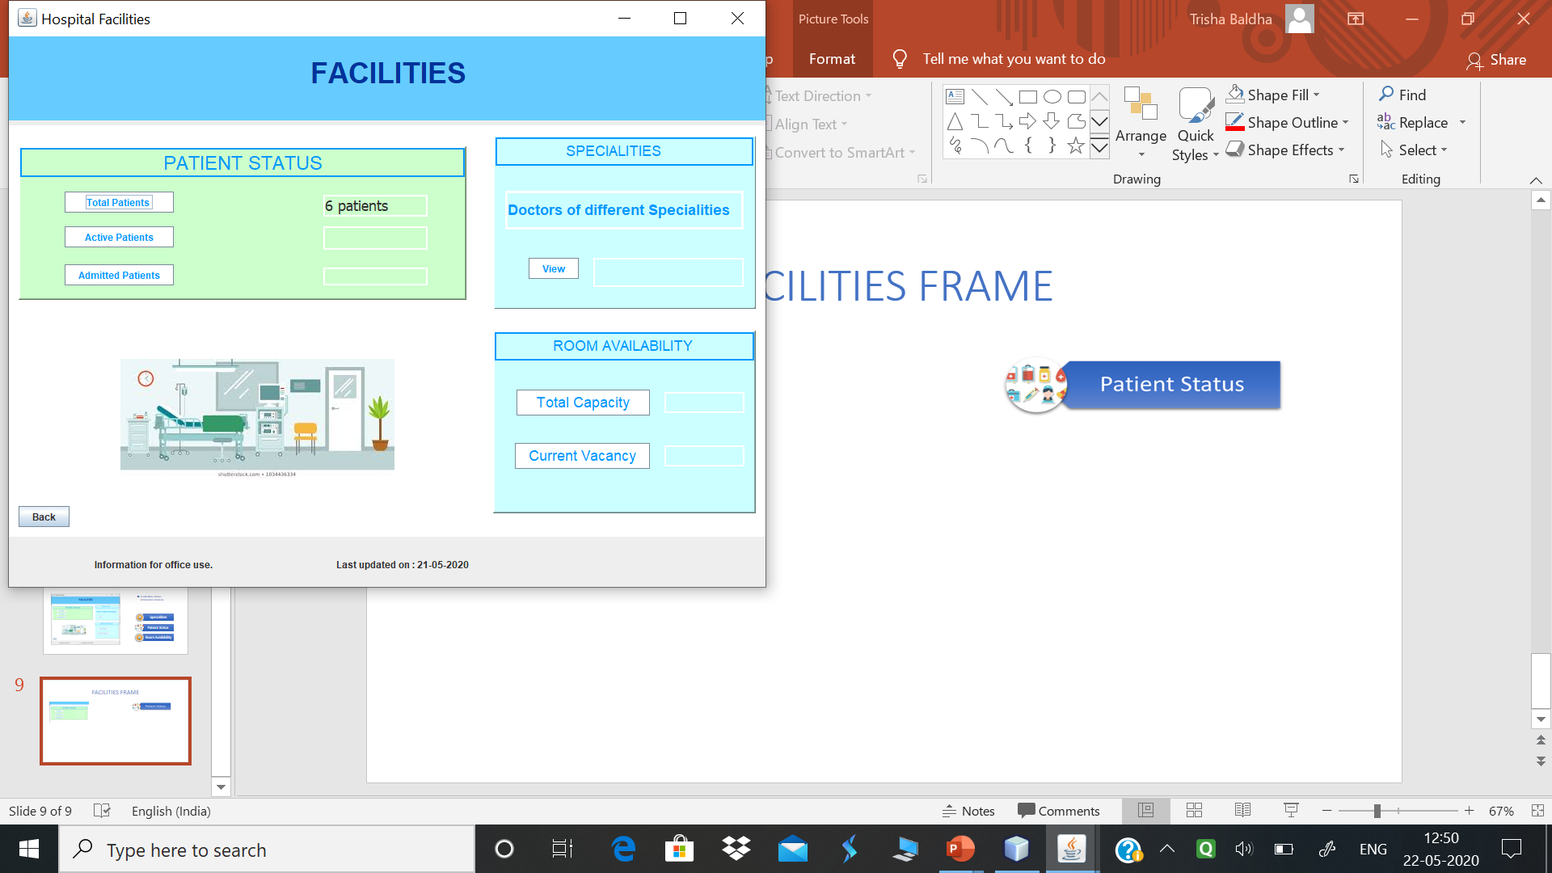



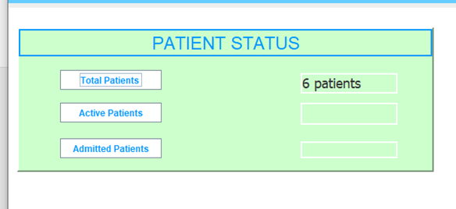
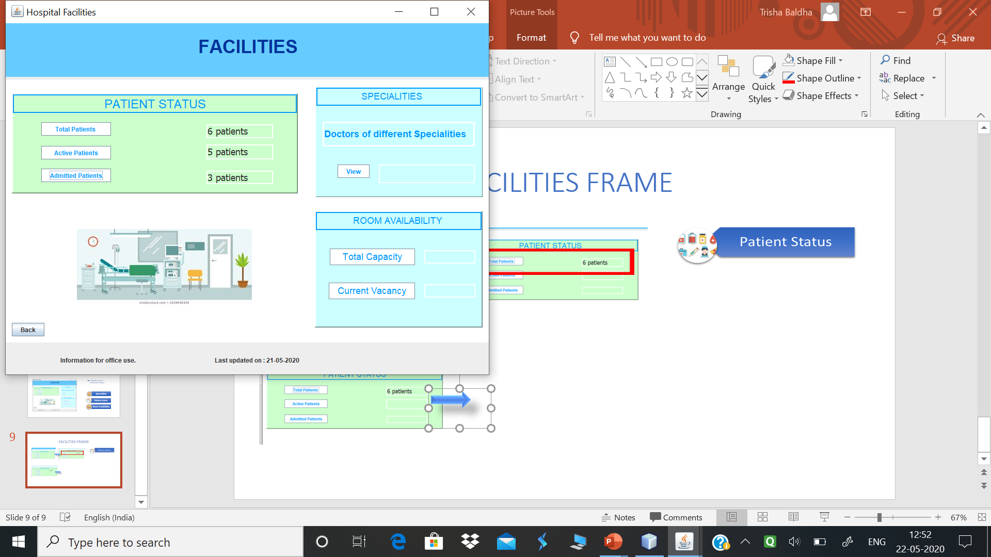

FACILITIES FRAME
Total number of patients who have taken treatment from hospital till date.
category of patients into:
Total patients include active and inactive both.
Active patients will be further divided in admitted and consulting.

Slide 20

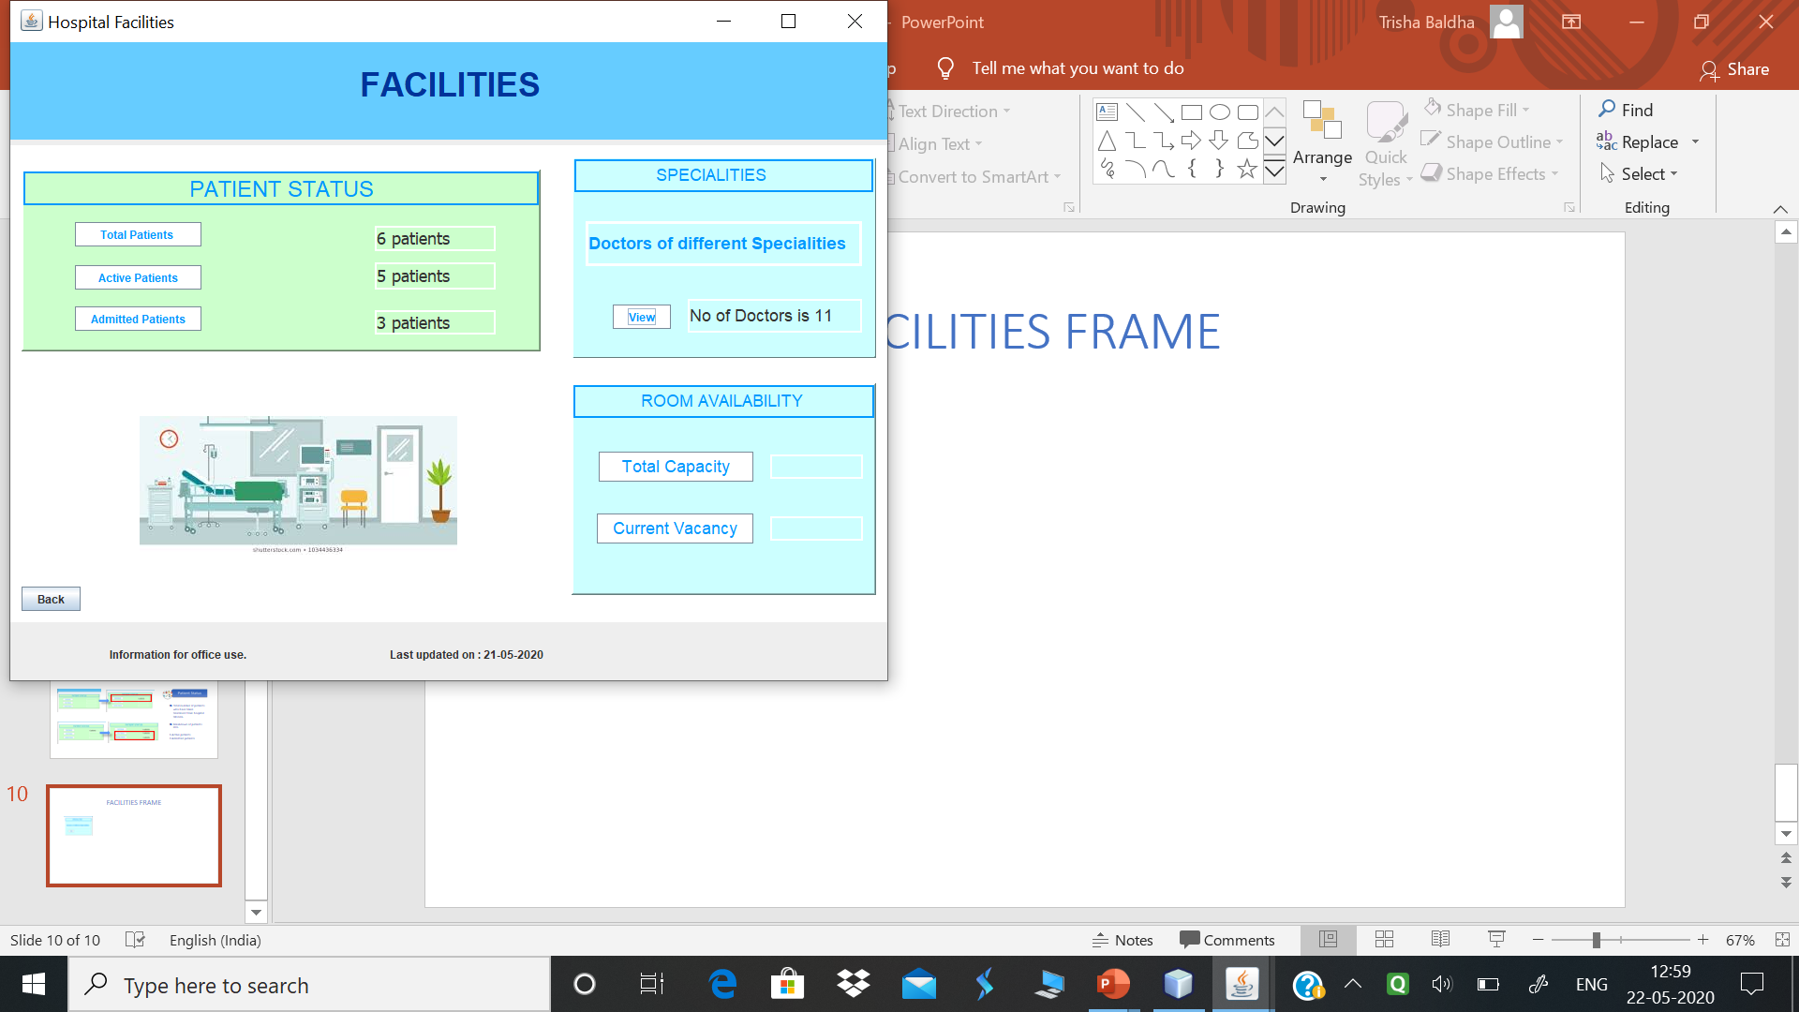


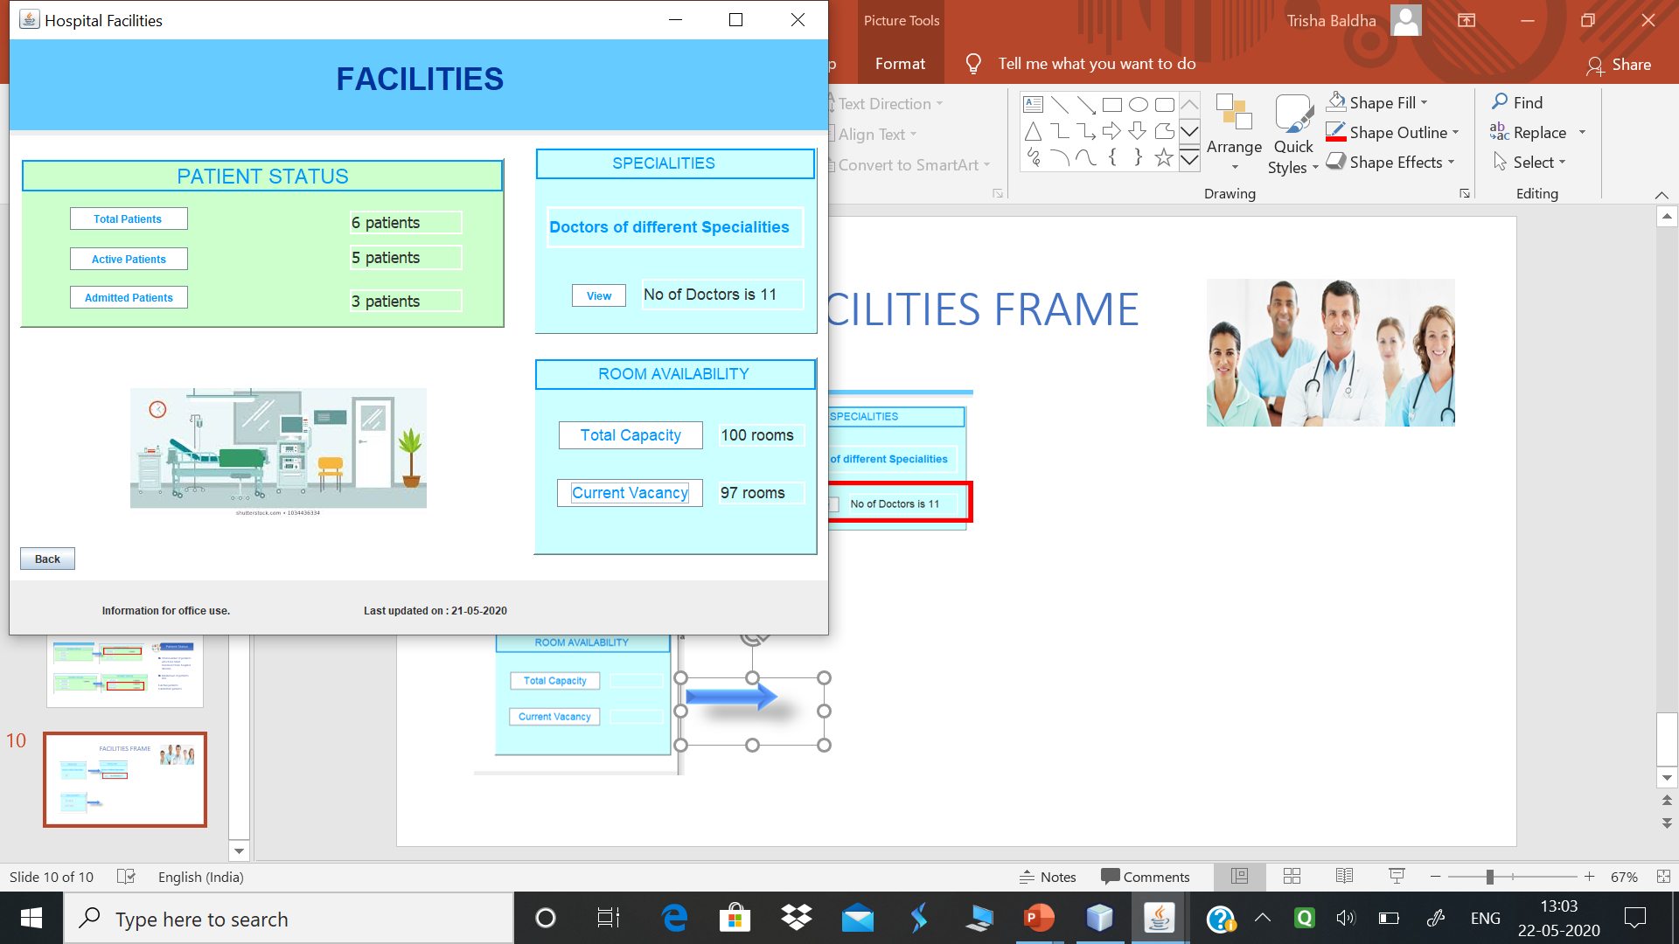




FACILITIES FRAME
It gives detail about the total number of doctors working in hospital.
Displays result on clicking view.
It gives information about total rooms and available rooms excluding occupied by admitted patients.
Result will be displayed by clicking by respective label.

Slide 21
IMPLEMENTATION DETAILS
Details about implementation of various OOCP concepts.
Details about implementation with example in different modules.
Screenshots from source code is included with implementation screenshots.

Slide 22
IMPLEMENTATION DETAILS
INHERITANCE
In object-oriented programming, inheritance is the mechanism of basing an object or class upon another object or class, retaining similar implementation. Also defined as deriving new classes from existing ones such as super class or base class and then forming them into a hierarchy of classes.

Slide 23
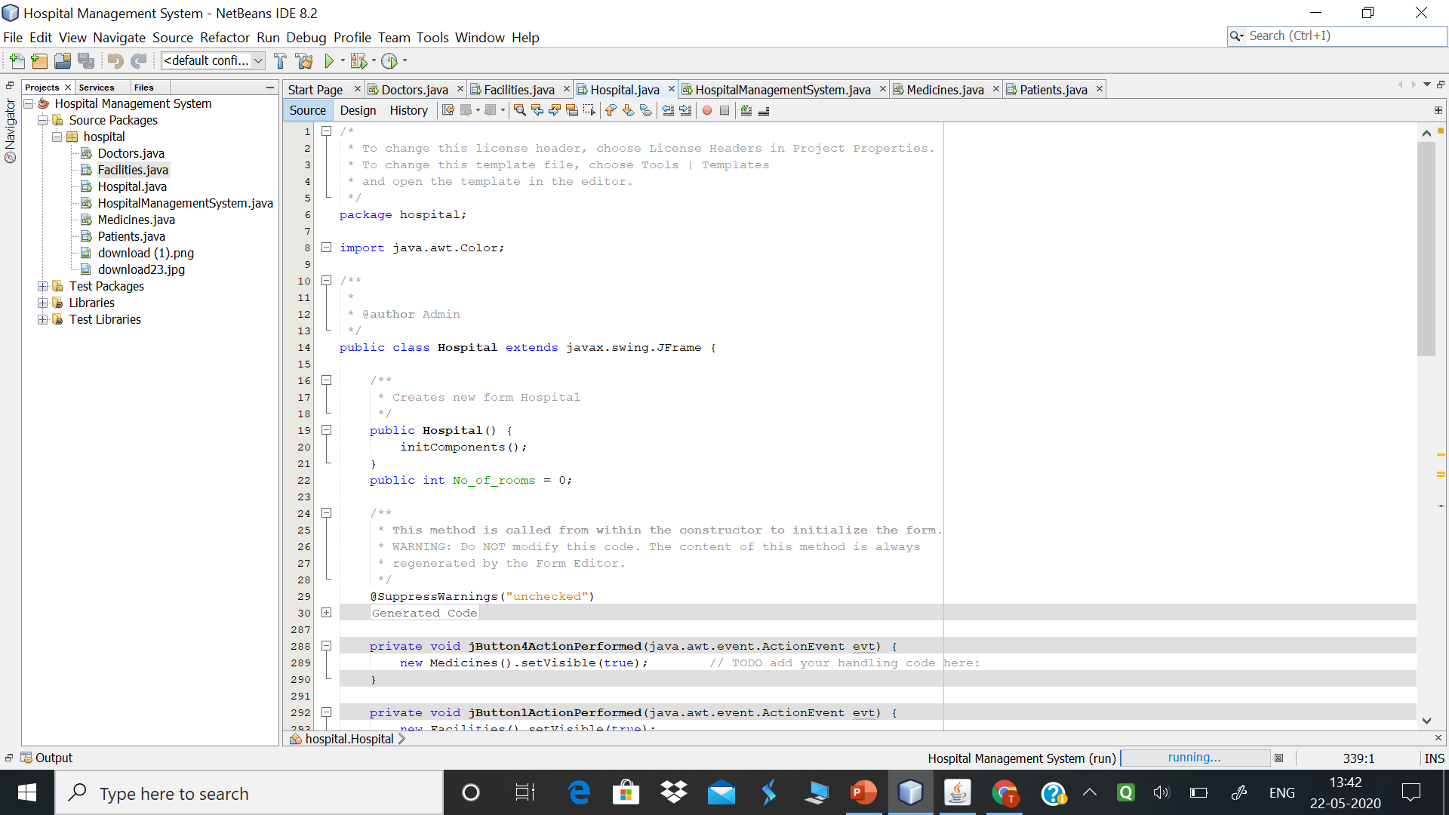
INHERITANCE
JFrame
Hospital
Here the Hospital class extends the JFrame class of swing.
It will inherit properties of JFrame and methods.
Source code details:
Hospital.java
Also implemented in :
Medicines.java
Patients.java
Doctors.java
Facilities.java

Slide 24
IMPLEMENTATION DETAILS
EXCEPTION HANDLING
Exception is an error event that can happen during the execution of a program and disrupts its normal flow. Java provides a robust and object oriented way to handle exception scenarios, known as Java Exception Handling.

Slide 25
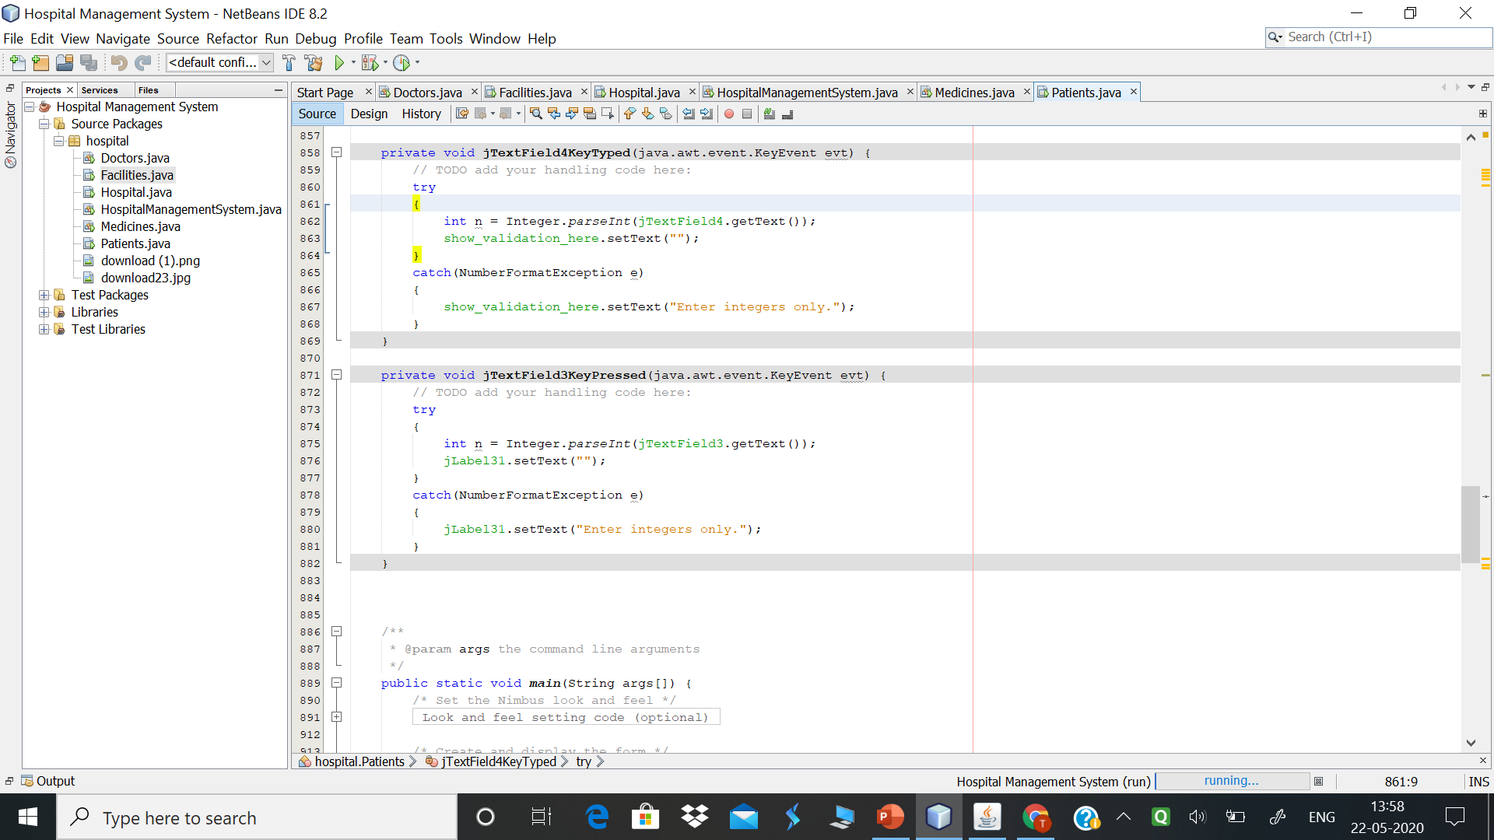
EXCEPTION HANDLING
Here exception handling is used when user enters any value other than integral. Message will be to enter correct value.
Source code:
Patients.java

Slide 26
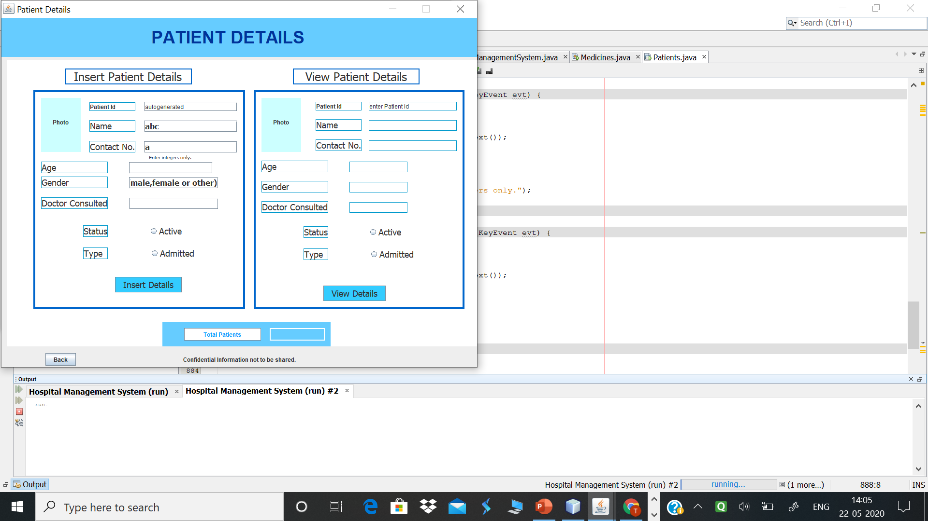
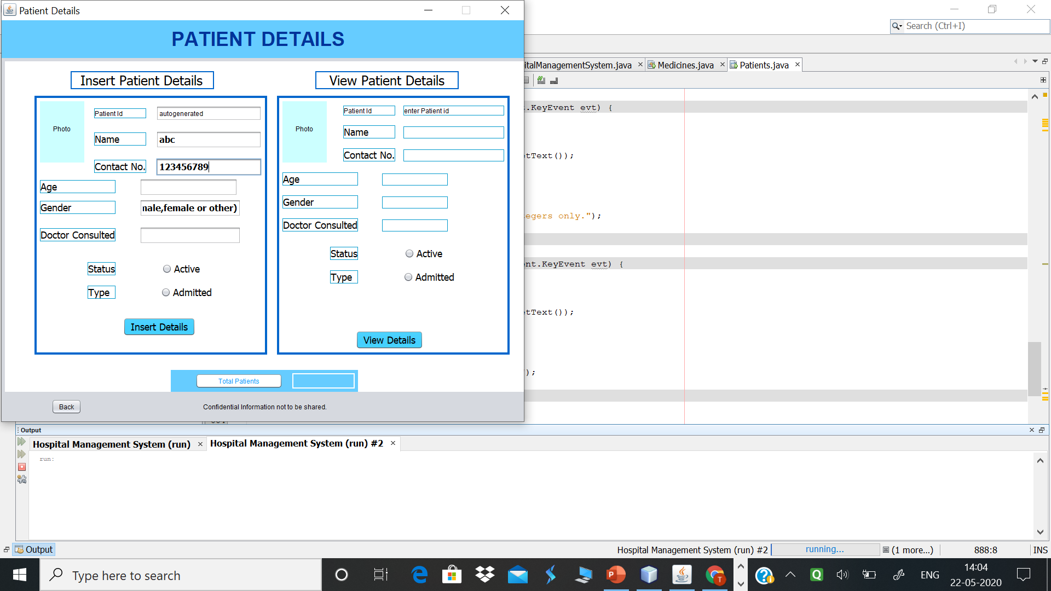

EXCEPTION HANDLING
Here exception will be handled and note will be displayed to add integer values only.

Slide 27
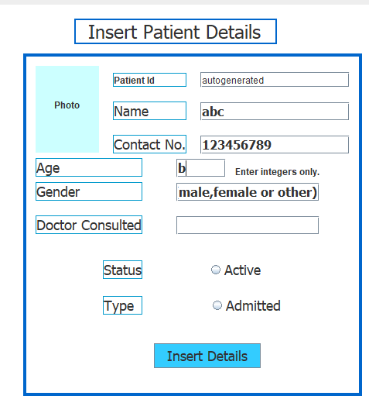
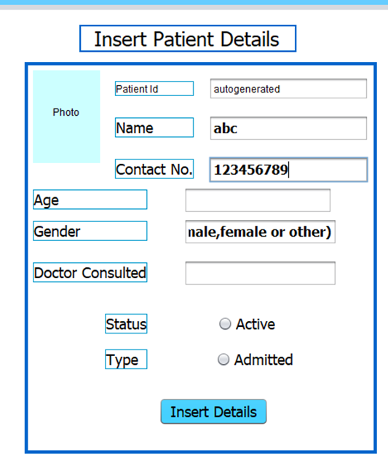

EXCEPTION HANDLING
Here the exception will be handled for not allowing non integral values in age field.

Slide 28
IMPLEMENTATION DETAILS
INTERFACE
An interface in the Java programming language is an abstract type that is used to specify a behavior that classes must implement. Interfaces are declared using the interface keyword, and may only contain method signature and constant declarations.

Slide 29
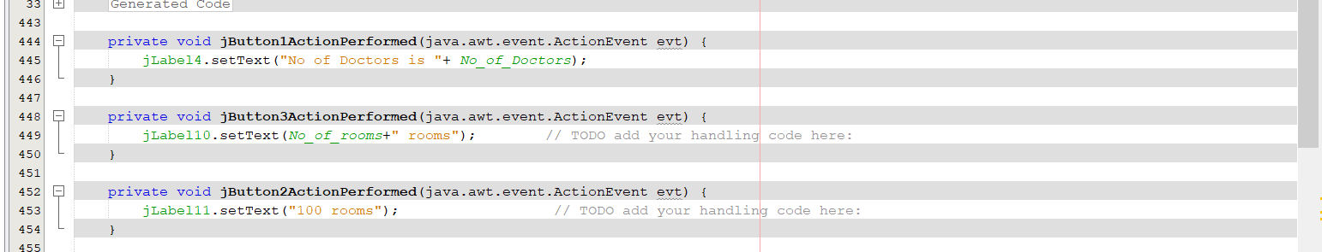
INTERFACE
ActionListener interface will be implemented to create object for action performed method. For this abstract methods user defined function can be created. For example on button click ActionPerformed method will be invoked in which object of class implementing ActionListener interface will be passed.
Source code:
Facilities.java

Slide 30
IMPLEMENTATION DETAILS
USING GRAPHICAL USER INTERFACE
The graphical user interface is a form of user interface that allows users to interact with electronic devices through graphical icons and audio indicator such as primary notation, instead of text-based user interfaces, typed command labels or text navigation.

Slide 31
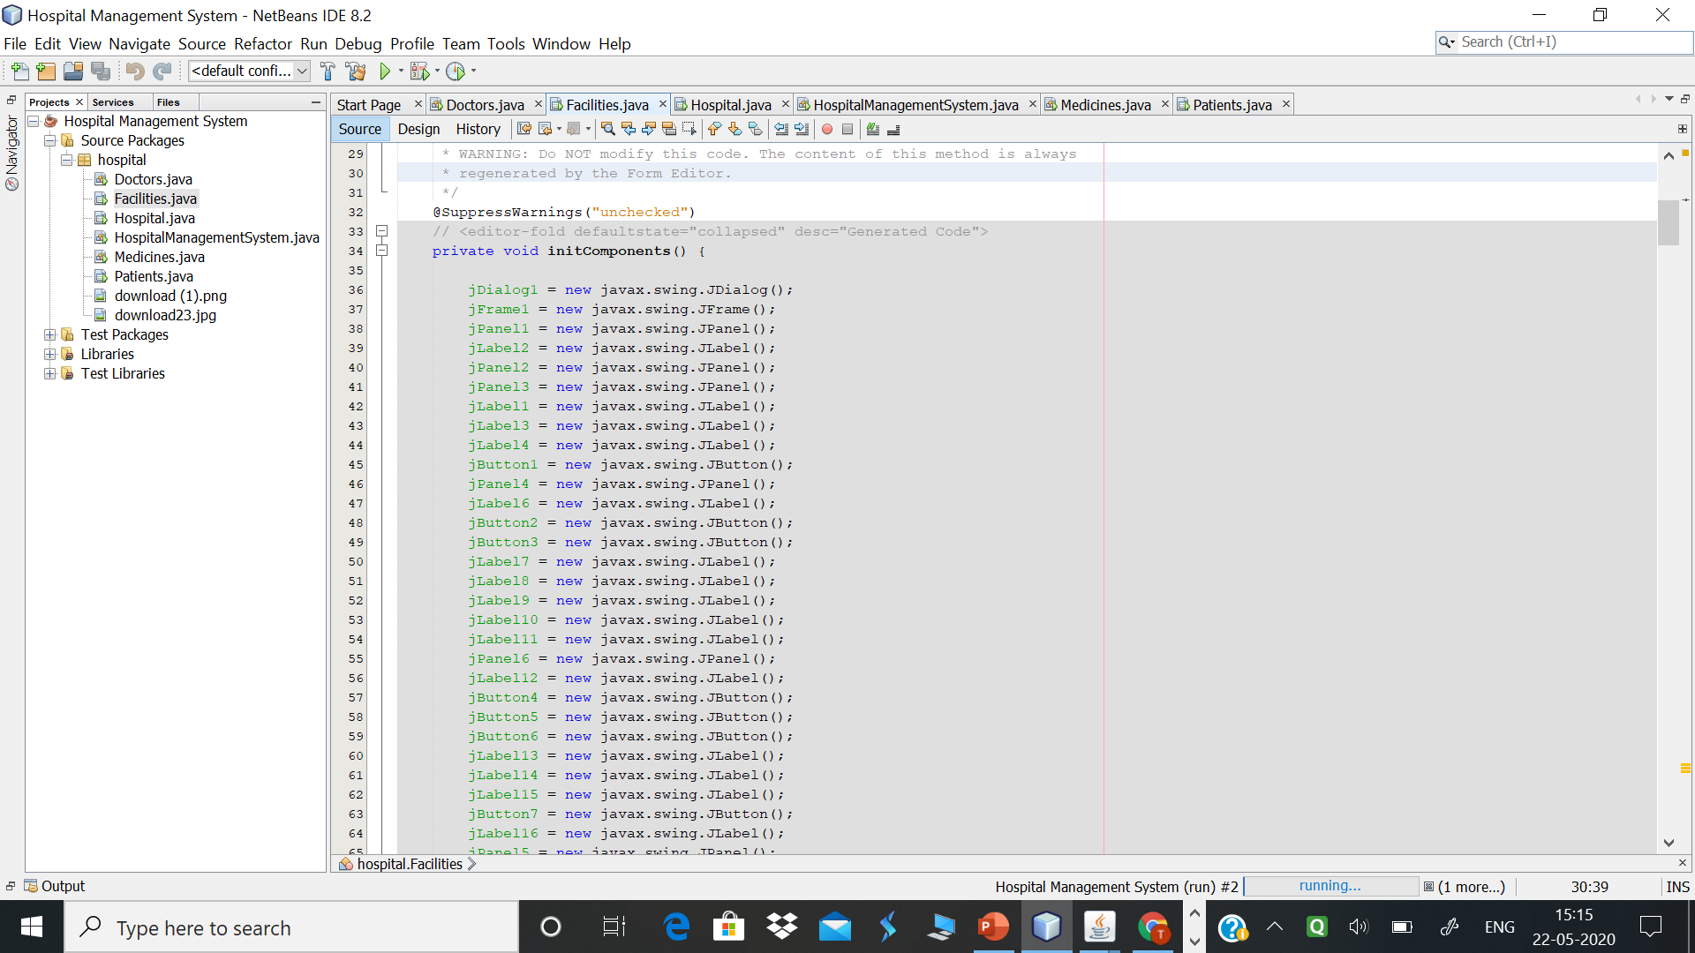
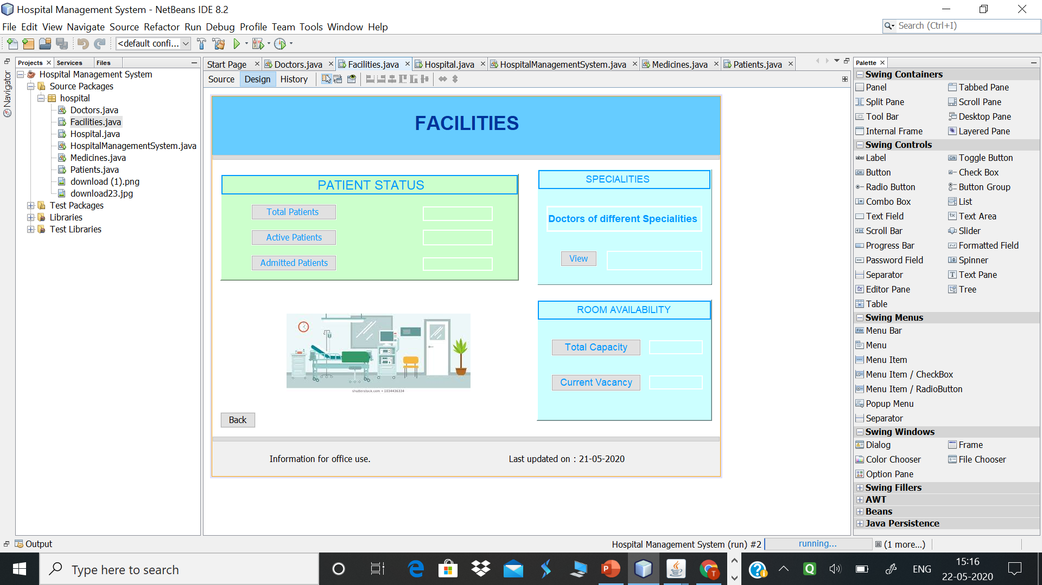
USING GRAPHICAL USER INTERFACE

Slide 32
IMPLEMENTATION DETAILS
ABSTRACT CLASS AND ABSTRACT METHOD
An abstract type is a type in a nominative type system that cannot be instantiated directly; a type that is not abstract – which can be instantiated – is called a concrete type. Every instance of an abstract type is an instance of some concrete subtype.

Slide 33
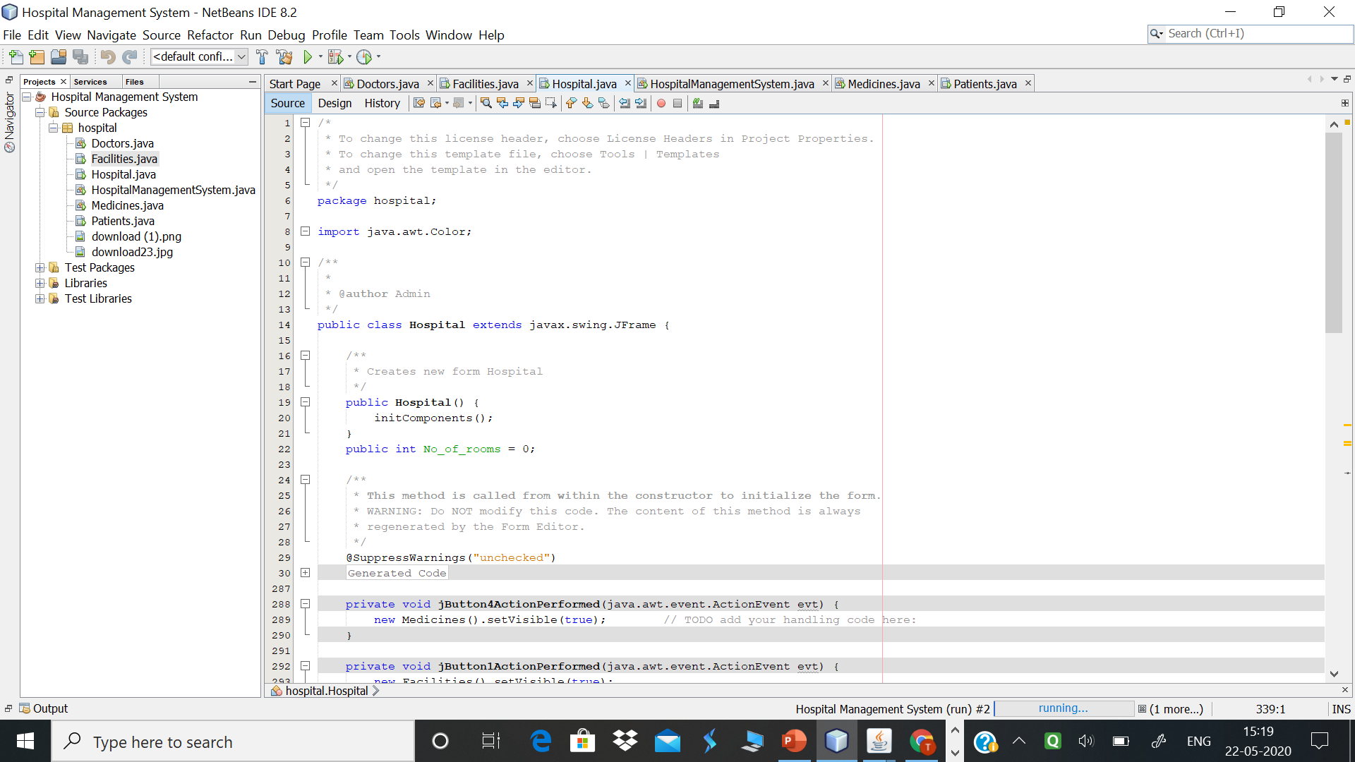
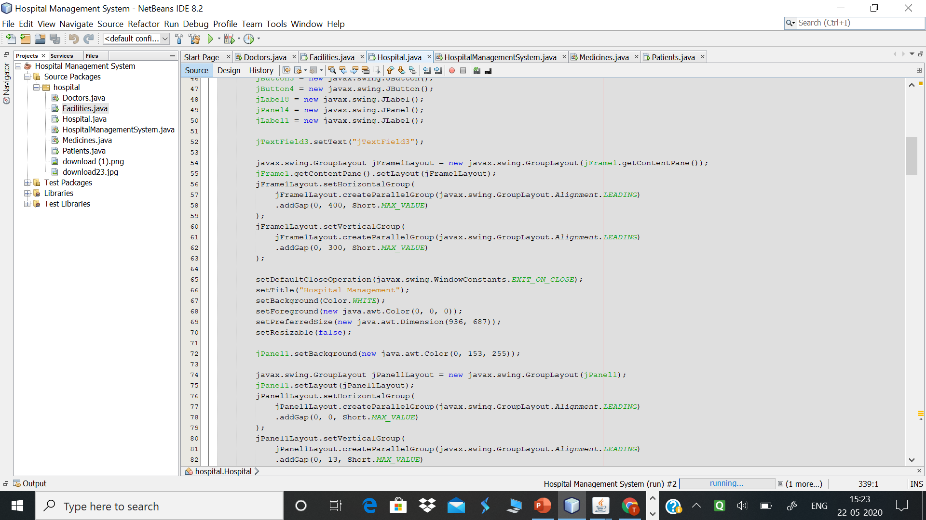
ABSTRACT CLASS AND ABSTRACT METHOD
Here abstract class JFrame is used. Where the Hospital class extends the JFrame abstract class. Here abstract methods like setDefaultCloseOperation are defined.
Source code:
Hospital.java

Slide 34
IMPLEMENTATION DETAILS
EVENT HANDLING
Event Handling is the mechanism that controls the event and decides what should happen if an event occurs. This mechanism have the code which is known as event handler that is executed when an event occurs.

Slide 35
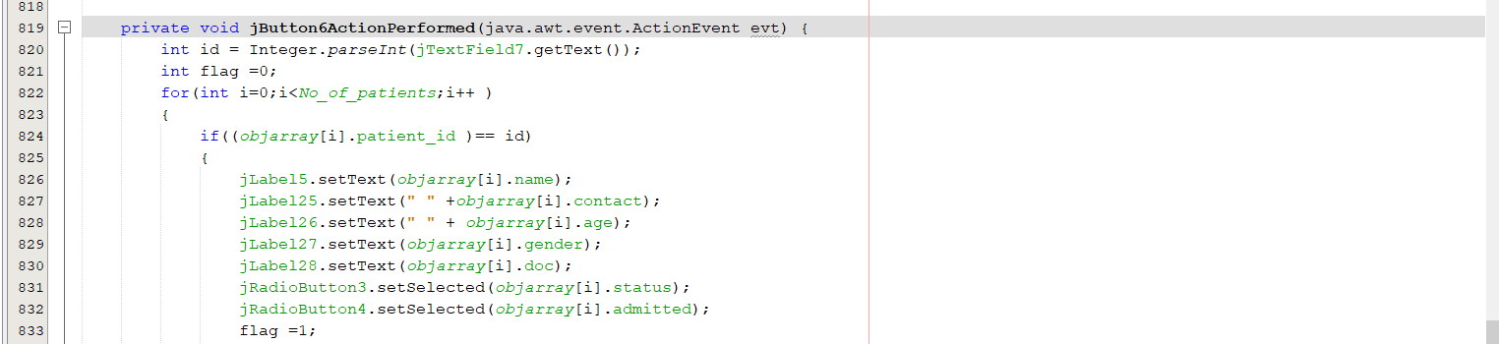
EVENT HANDLING
For handling event like button click ActionPerformed method will be invoked and performed. Here on button click patient details can be displayed.
Source code:
Patients.java

Slide 36
IMPLEMENTATION DETAILS
MULTITHREADING
Multithreading in Java is a process of executing multiple threads simultaneously. A thread is a lightweight sub-process, the smallest unit of processing. Multiprocessing and multithreading, both are used to achieve multitasking.

Slide 37
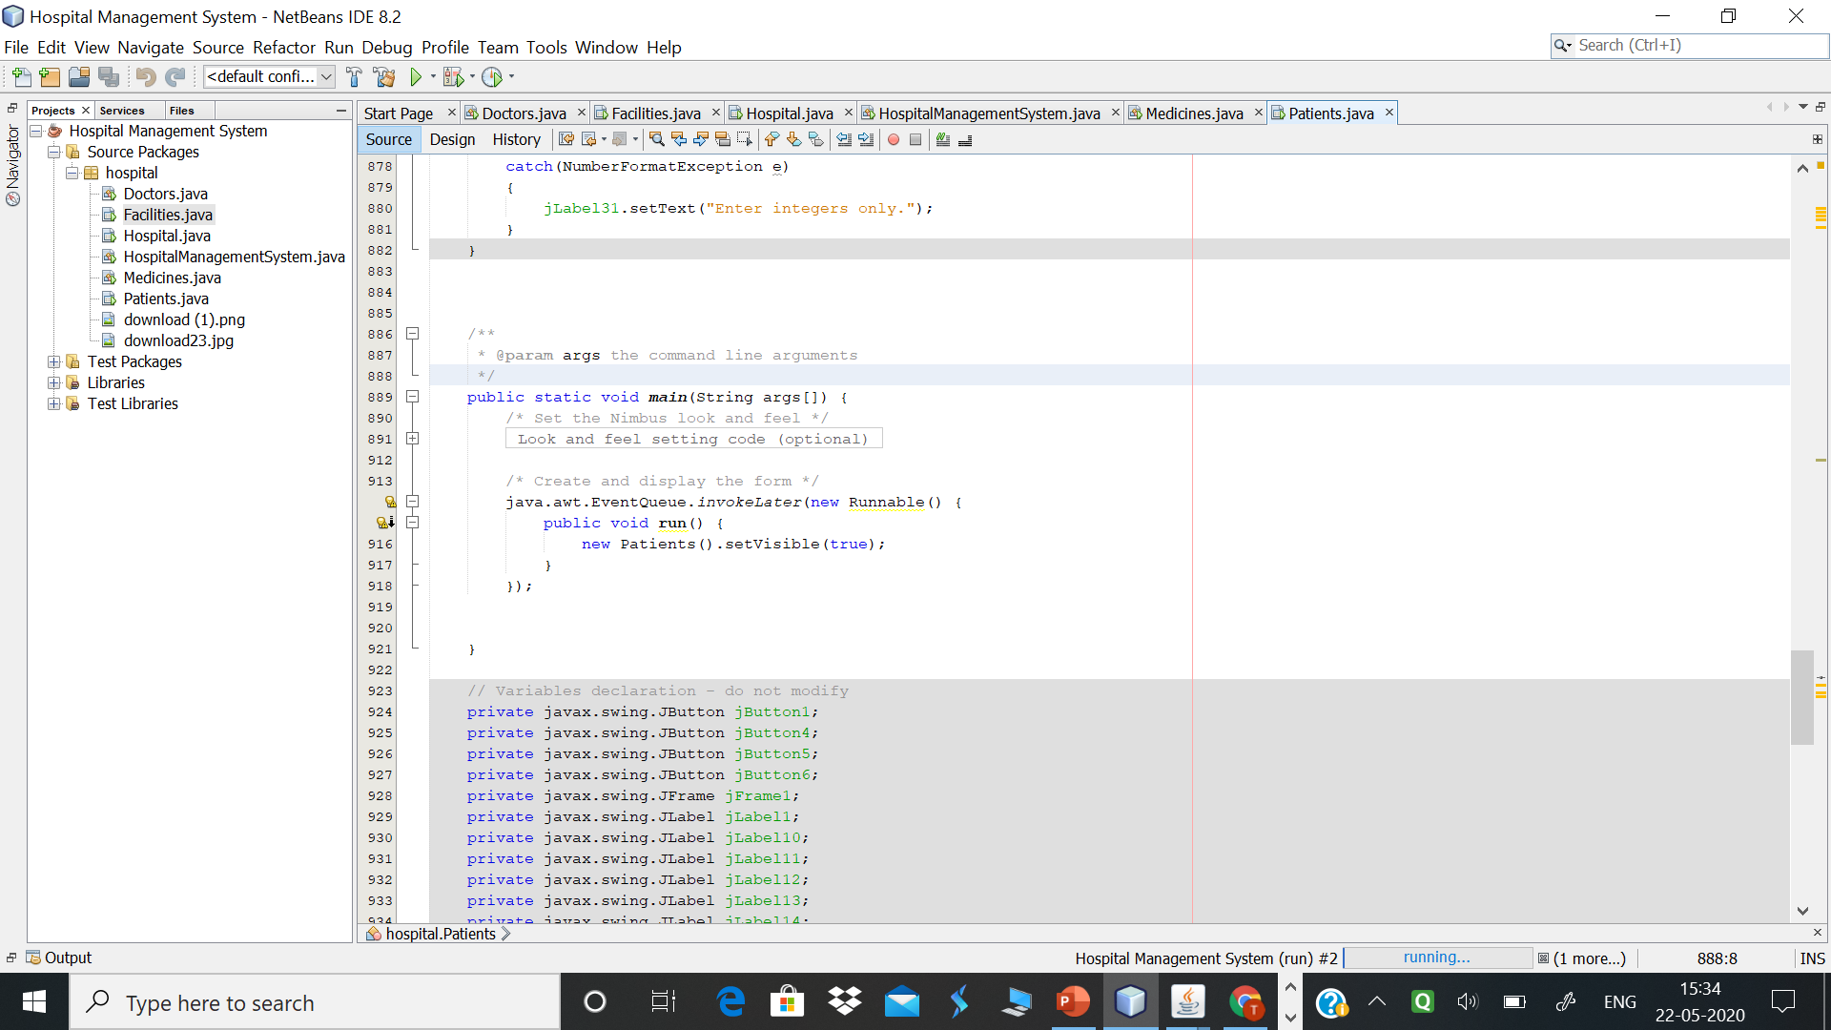
MULTITHREADING
The Runnable interface is implemented by any class whose instances are intended to be executed by a thread. The class must define a method of no arguments called run . This interface is designed to provide a common protocol for objects that wish to execute code while they are active.
Source code:
Patients.java

Slide 38
BENEFITS
It gives a vivid picture of future hospital growth.
Hospital Management System is easy to use and eliminates errors caused by handwriting.
It enhances the overall health care experience in a healthcare facility.
Integrated Inventory Management keeps track of all hospital stocks from medicines to linens and helps you keep the optimum level of stock all the time. It also minimizes the lost stock due to theft and misplacement.
Data remains confidential.

Slide 39
APPLICATIONS
Easily managed patient details.
Repository can be maintained to check stocks.
If we link it with database, the information can be stored permanently and more efficiently.
Making the same project with the use of additional languages like HTML and CSS, we can make it interactive for the patients as well by creating login modules.

Slide 40
Thank You!

